Slide 1
Microsoft 365 platform community call
aka.ms/m365pnp
Your host in this call: Vesa Juvonen
September 13, 2022

Slide 2




Agenda
Latest updates and news on the Microsoft 365 platform
Updates on the Microsoft Teams documentation
Group picture time with Together Mode!
Demos
Rabeb Othmani - Microsoft Graph Postman - Scripts and advanced functionality
John Miller – Introduction to Microsoft Teams Toolkit
Bob German - Introduction to app camp

Slide 3
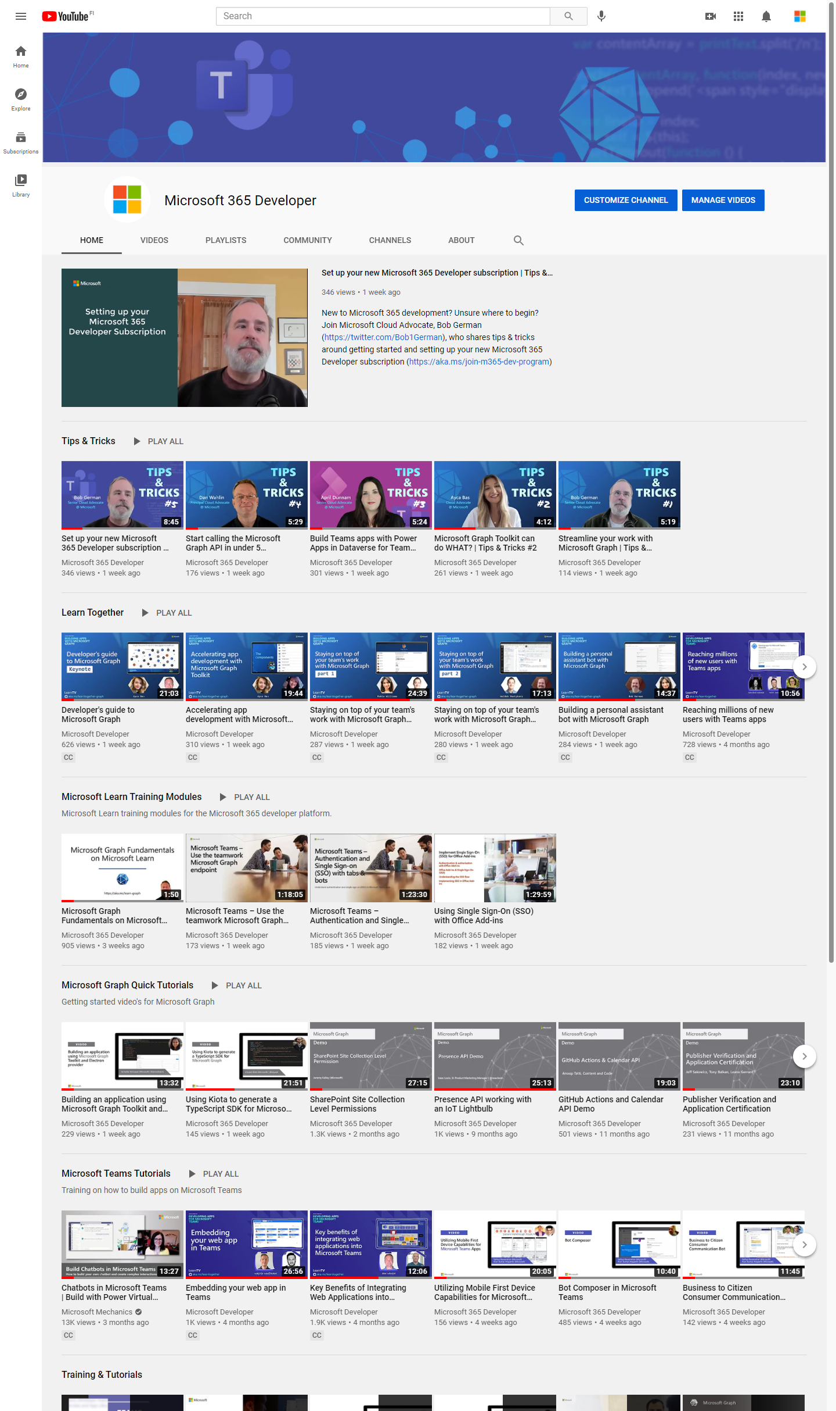
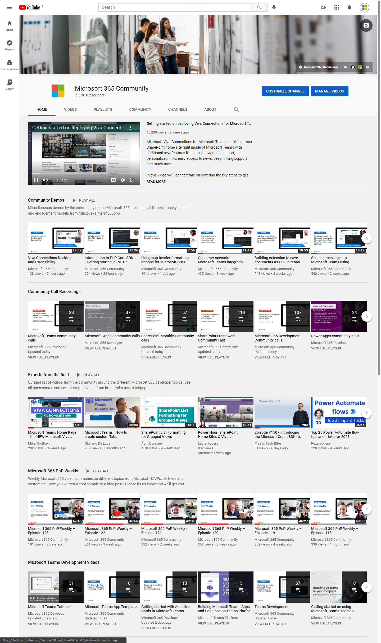
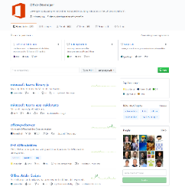
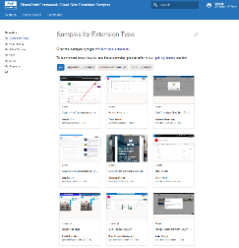
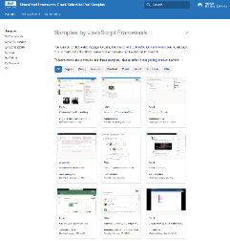
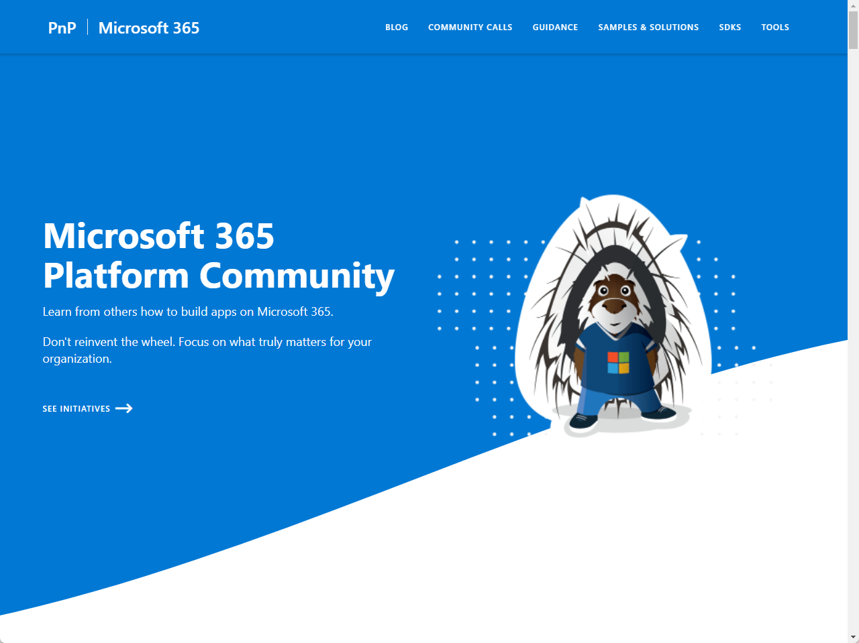
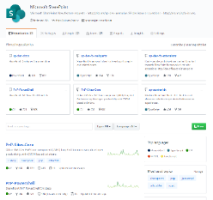
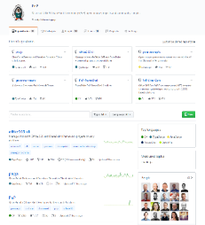
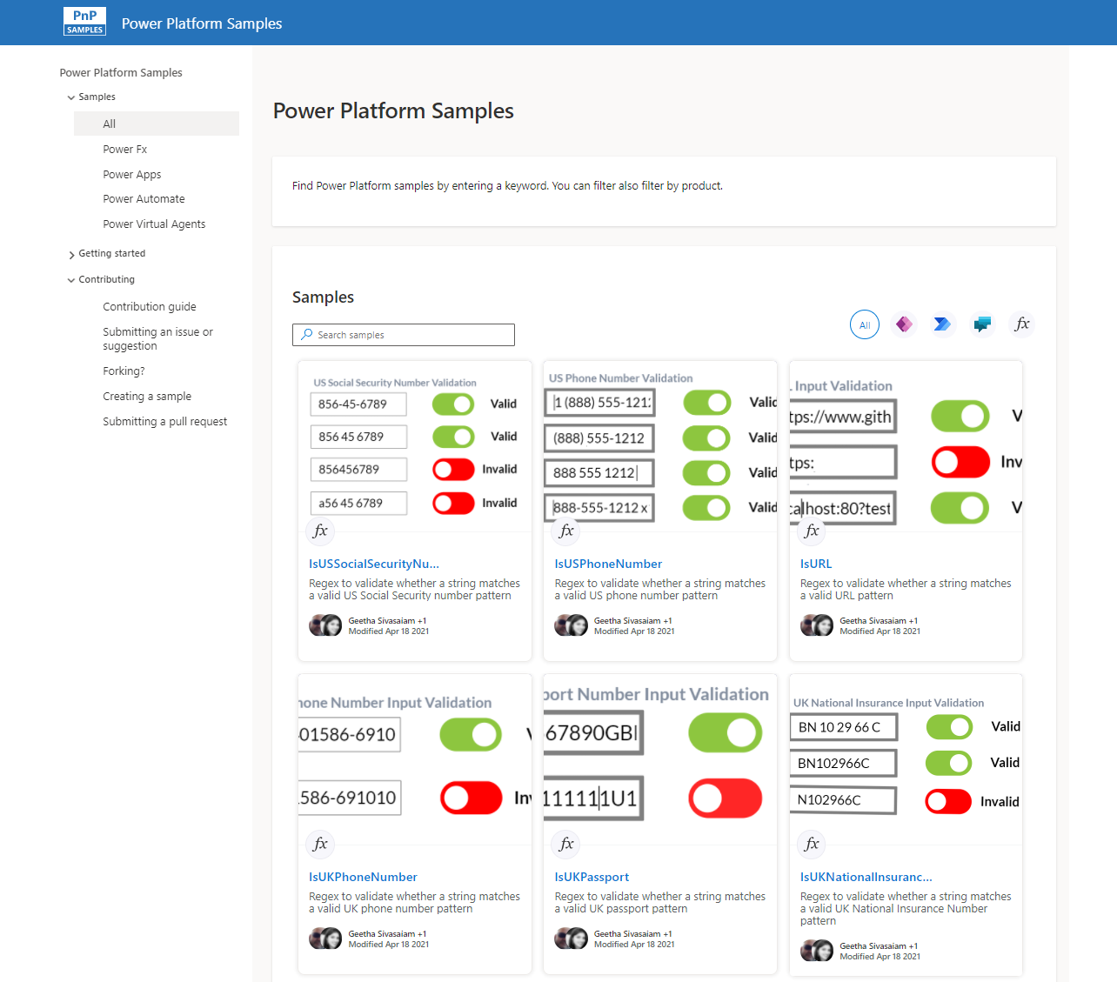
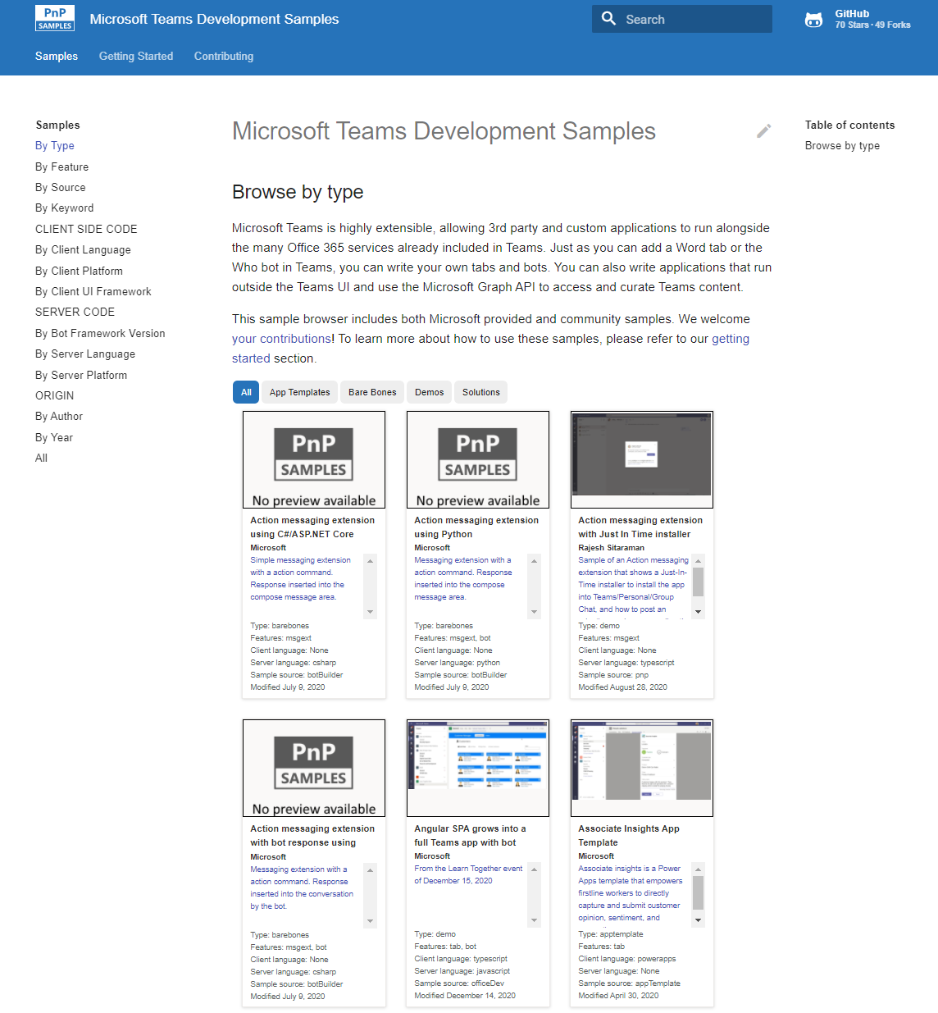
Microsoft 365 developer videos
Microsoft 365 community videos
Open-source
Sample galleries
Open-source initiatives and samples
aka.ms/m365devyoutube
aka.ms/m365/videos
github.com/pnp
github.com/officedev
github.com/sharepoint
github.com/microsoftgraph
aka.ms/m365/samples
aka.ms/teams-samples
aka.ms/spfx-webparts
aka.ms/powerplatform-samples
aka.ms/spfx-extensions
aka.ms/list-formatting
aka.ms/m365/community
@Microsoft365Dev | @m365pnp

Slide 4
Microsoft 365 developer community calls
Microsoft 365 platform (weekly) https://aka.ms/m365-dev-call
Adaptive Cards https://aka.ms/adaptivecardscommunitycall
Microsoft identity platform https://aka.ms/IDDevCommunityCalendar
Office Add-ins https://aka.ms/officeaddinscommunitycall
Power Platform https://aka.ms/PowerAppsMonthlyCall
Microsoft 365 and Power Platform community (bi-weekly) https://aka.ms/m365-dev-sig
Viva Connections & SharePoint Framework (bi-weekly) https://aka.ms/spfx-call
Download recurrent invites from
https://aka.ms/m365/calls
Notes:
m365-dev-sig

Slide 5

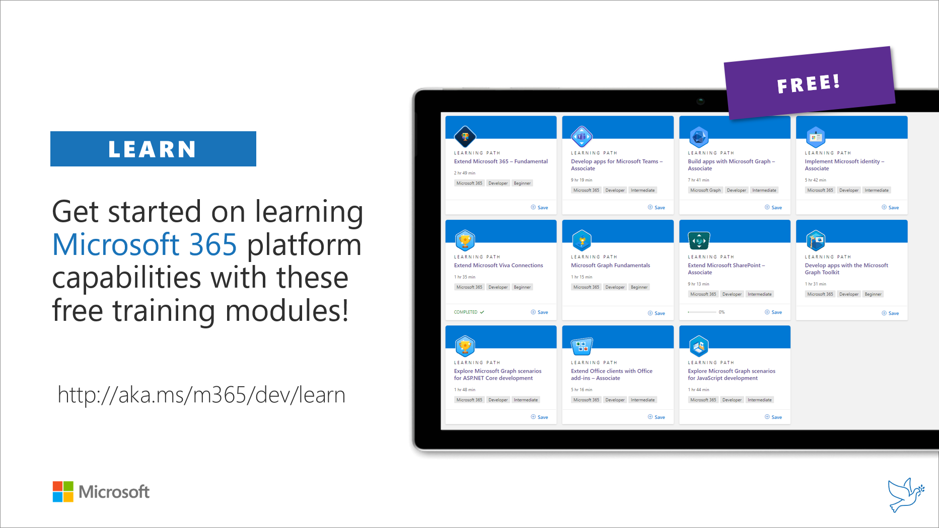
Getting started assets for Microsoft 365 dev
aka.ms/m365/devprogram
aka.ms/m365/dev/learn

Slide 6

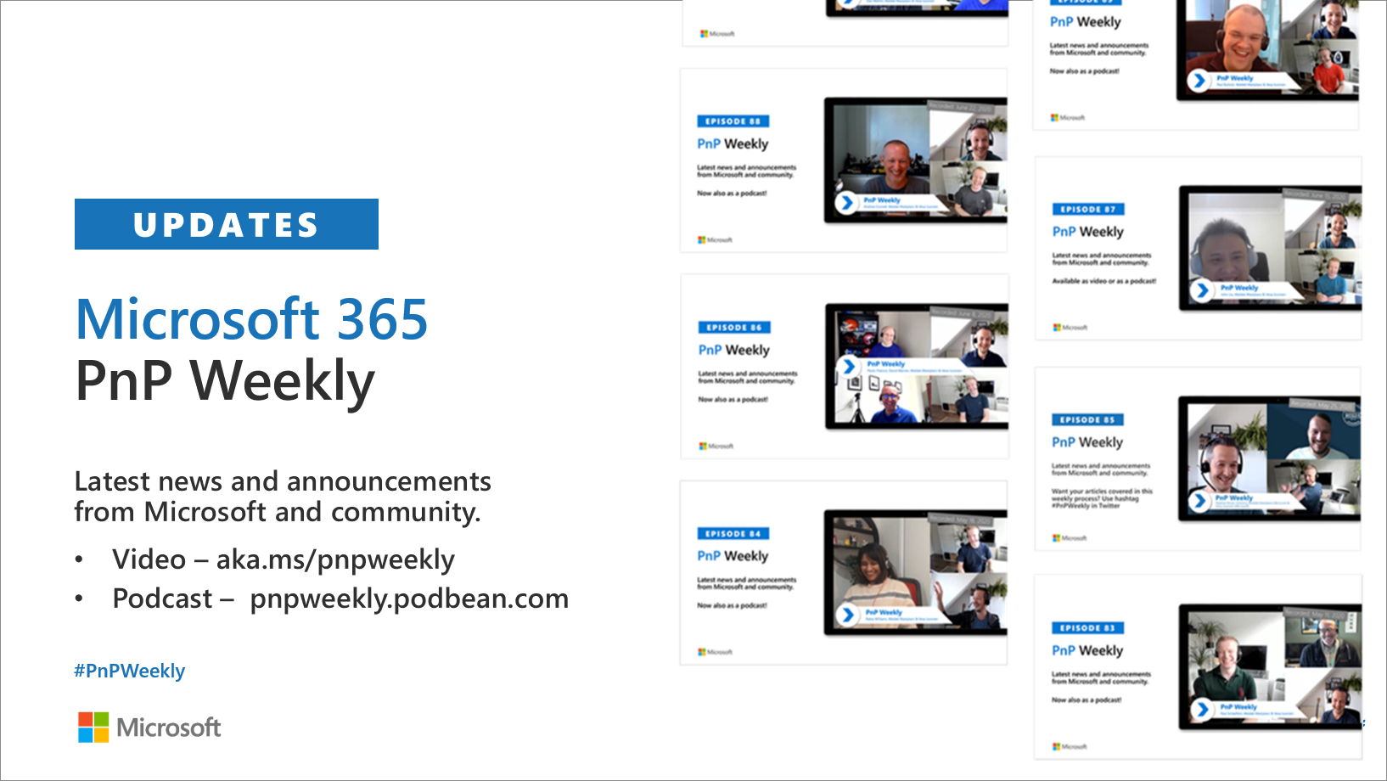
Microsoft 365 Developer podcasts
m365devpodcast.com
Video – aka.ms/pnpweekly
Podcast – pnpweekly.podbean.com

Slide 7

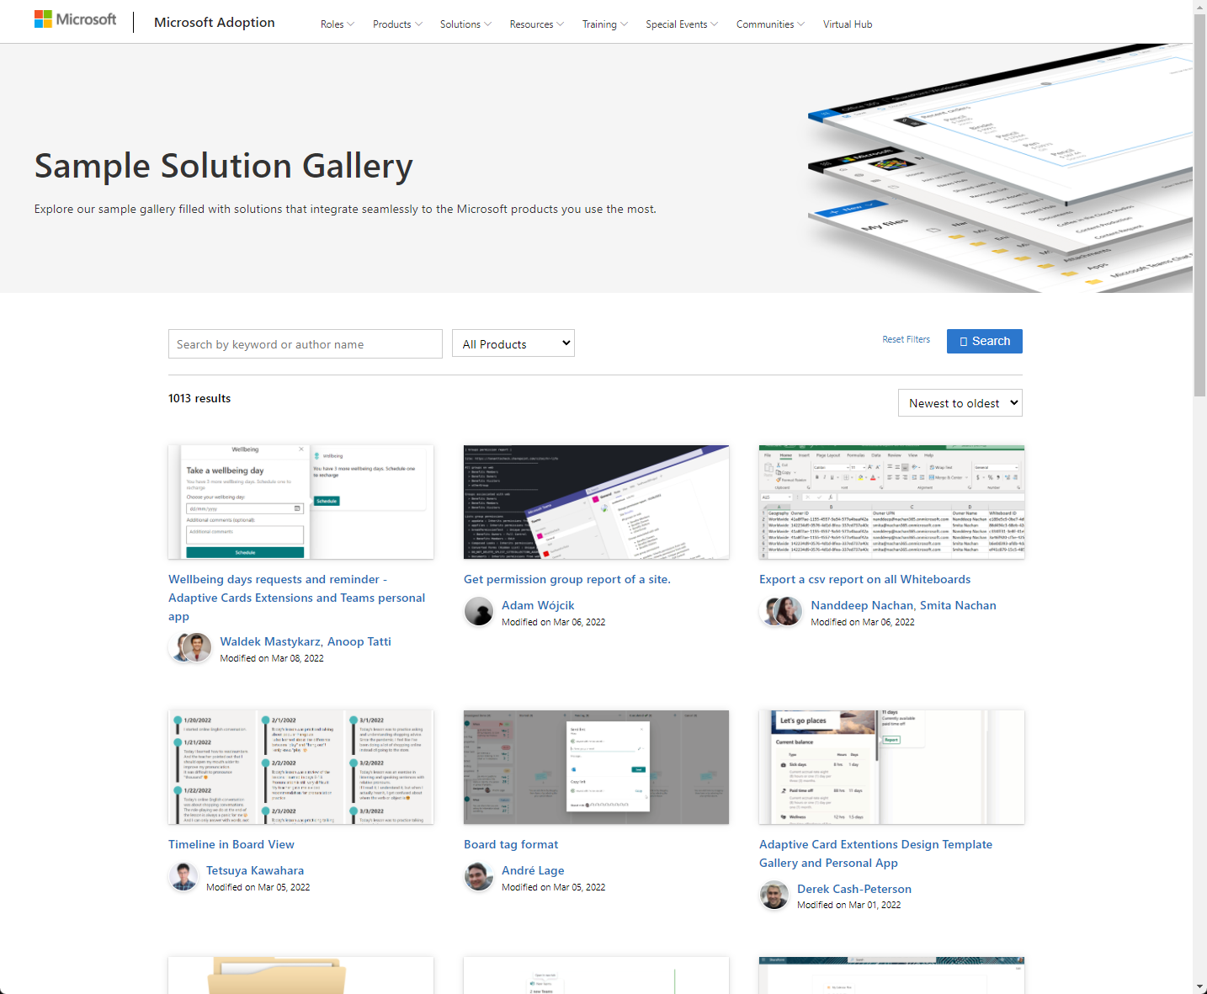
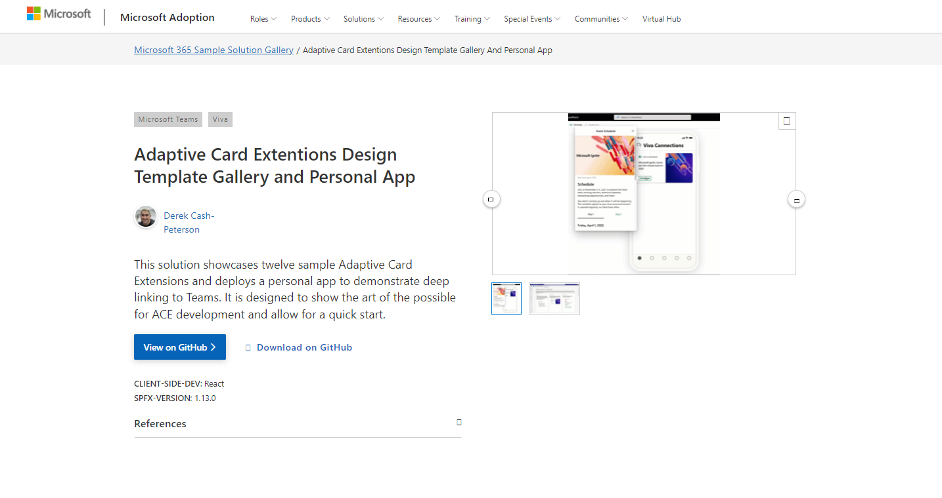
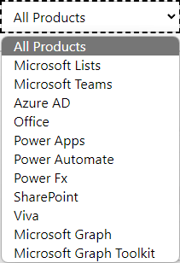

SAMPLES
New Microsoft 365 sample gallery with more than 500 samples from Microsoft and community
1100
aka.ms/m365/samples

Slide 8

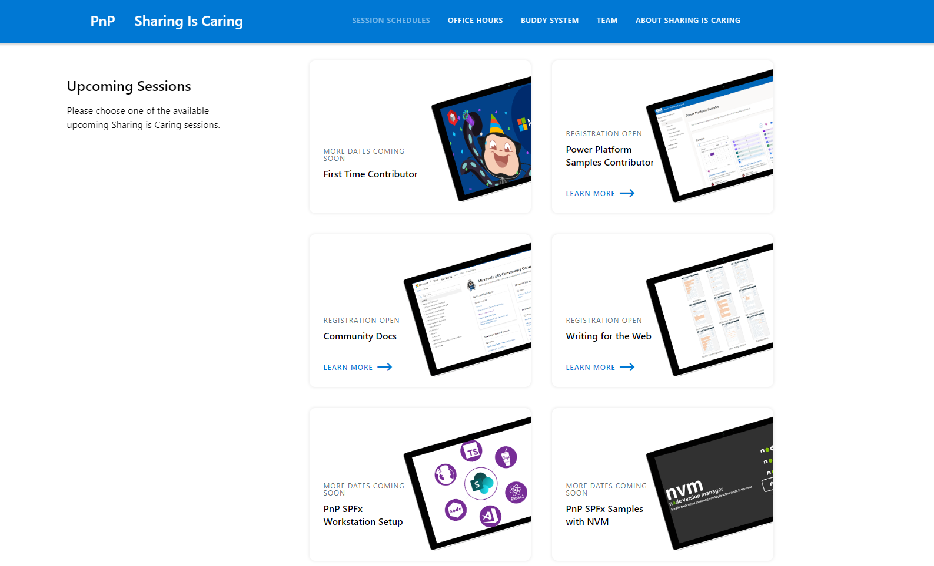
GUIDANCE
Learn how to get started in the open-source PnP community!
Upcoming Sessions:
General First Time Contributor
Power Platform Samples Contributor
Writing for the Web
SPFx Developer Workstation Setup
Using PnP SPFx samples w/ NVM
More than code with VS Code
First-time presenter
M365 Maturity Model Practitioners
Power Platform Samples Contributor
Power Platform
Conference Session
https://aka.ms/sharing-is-caring
Notes:
25 Total attendees, 16 attendees who attended both First-Time Contributors and Community Docs sessions.

Slide 9

https://aka.ms/app-camp

Slide 10

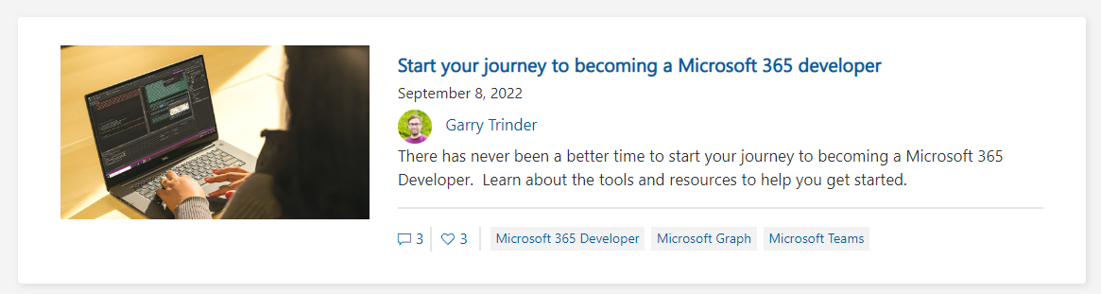
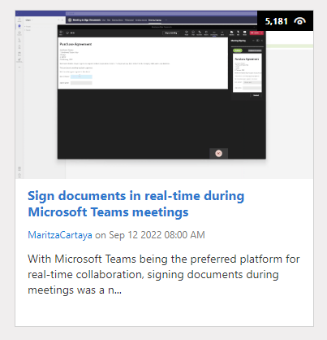
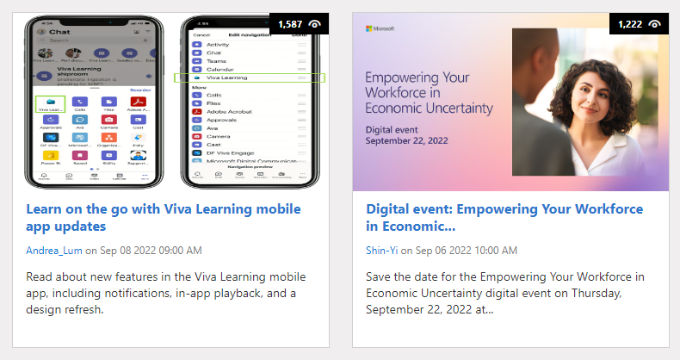
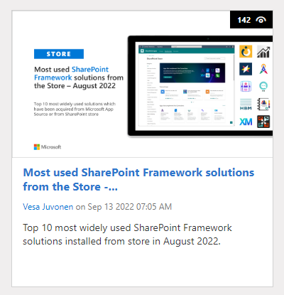
https://aka.ms/m365dev/blog
https://aka.ms/teams/blog
https://aka.ms/microsoftviva/blog
https://aka.ms/sp-blog
Notes:
Empowering Your Workforce in Economic Uncertainty Thursday, September 22, 2022 9:00 AM–9:45 AM Eastern Time

Slide 11
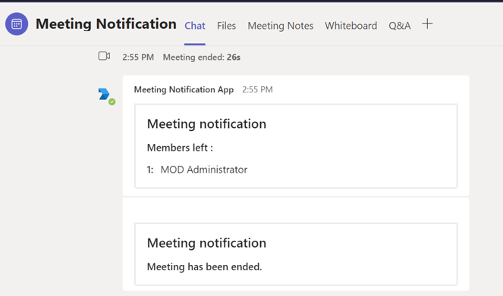
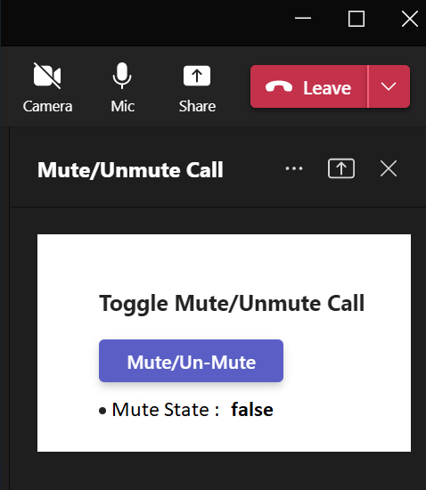
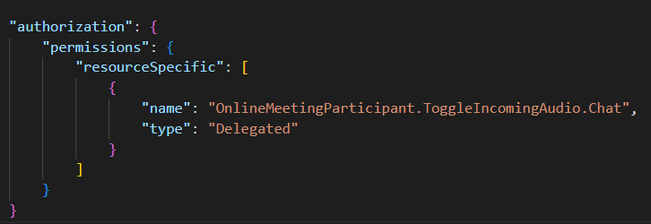






Teams Platform updates Samples update
1
Online meeting subscription to including resource data (Beta)
2
Toggle incoming audio using Teams JS SDK (Dev Preview)
Manifest change:
Sample: http://aka.ms/TeamsSamples > samples > graph-meeting-notification Docs: https://docs.microsoft.com/en-us/graph/api/resources/subscription
Sample: http://aka.ms/TeamsSamples > samples > meetings-audio-state Docs: aka.ms/TeamsDevDocs >Build apps for Teams meetings and calls > Meeting apps API references
@Microsoft365Dev
aka.ms/TeamsPlatformUpdates
aka.ms/TeamsDevDocs
aka.ms/TeamsSamples
aka.ms/TeamsPlatformFeedback
Notes:
Surbhi covering 9/13/2022 Hello everyone. I’d walk you through the Teams platform updates. We have two new samples.
First, we have Online meeting subscription sample. This is a sample that demonstrates the use of online meeting subscription and sends you the notifications in a chat using bot, and includes the resource data along with the notification. This sample is published at aka.ms/TeamsSamples under graph-meeting-notification folder. Please note that this APIs is currently in Beta.
Second sample show how toggleIncomingClientAudio API allows an app to toggle the incoming audio state setting for the meeting user from mute to unmute or vice-versa. The API is available through the Teams client SDK. This sample is published at aka.ms/TeamsSamples under meetings audio states folder. Note that this feature is available in Public Developer Preview and you need to add OnlineMeetingParticipant.ToggleIncomingAudio.Chat in your app manifest before calling this method.
So, these were the platform updates, if you have any feedback or suggestion, please post on aka.ms/TeamsPlatformFeedback- the link is available in the footer. You could also follow us on twitter and configure to the RSS feeds to get regular platform updates.

Slide 12


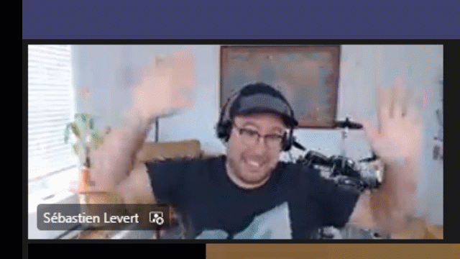
Optional picture time!
Video on and we’ll grab a Together Mode pic with those who are willing to do this.
We are together on this as a community!
Let’s all be like Seb
By enabling your camera for the picture, you grant us permission to share your picture in social media.

Slide 13

DEMO
Microsoft Graph Postman - Scripts and advanced functionality – Rabeb Othmani
Introduction to Microsoft Teams Toolkit – John Miller
Introduction to app camp – Bob German

Slide 14
Thank you
Recording will be available in 24 hours on
Microsoft 365 Community (PnP) YouTube channel
https://aka.ms/m365/videos
(subscribe today)
Follow us on Twitter
@Microsoft365Dev | @M365PnP
Next Microsoft 365 Platform call: September 20th at 08:00 am PT
All available community calls from https://aka.ms/m365/calls

Slide 15



aka.ms/m365pnp

